Slide 1
CS210: Computer Science II

Slide 2
Unit 1 Module 2: STRUCTURES
Accessing Structure Members
Initializing a Structure
Arrays of Structures
Nested Structures
Structures as Function Arguments
Returning a Structure from a Function
Pointers to Structures
Efficiency notes regarding Structures

Slide 3
Structures or Structs
A structure can be viewed as an object
Contains no member functions (The structures used here have no member functions)
Contains multiple values of possibly different types
The multiple values are logically related as a single item
Example: A bank Certificate of Deposit (CD) has the following values: a balance an interest rate a term (months to maturity)

Slide 4
Combining Data into Structures
Structure: C++ construct that allows multiple variables to be grouped together
General Format:
struct <structName>
{
type1 field1;
type2 field2;
. . .
};

Slide 5
Example struct Declaration
struct Student
{
int studentID;
string name;
short yearInSchool;
double gpa;
};
structure tag
structure members

Slide 6
struct Declaration Notes
Must have ; after closing }
struct names commonly begin with uppercase letter
Multiple fields of same type can be in comma-separated list:
string name,
address;

Slide 7
The CD Definition
The Certificate of Deposit structure can be defined as struct CDAccount { double balance; double interest_rate; int term; //months to maturity };
Keyword struct begins a structure definition
CDAccount is the structure tag or the structure’s type
Member names are identifiers declared in the braces
Remember this semicolon!

Slide 8
Defining Variables
struct declaration does not allocate memory or create variables
To define variables, use structure tag as type name:
Student bill;
bill
studentID
name
yearInSchool
gpa

Slide 9
Accessing Structure Members
Use the dot (.) operator to refer to members of struct variables:
cin >> stu1.studentID;
getline(cin, stu1.name);
stu1.gpa = 3.75;
bill.gpa = 3.95;
Member variables can be used in any manner appropriate for their data type

Slide 10
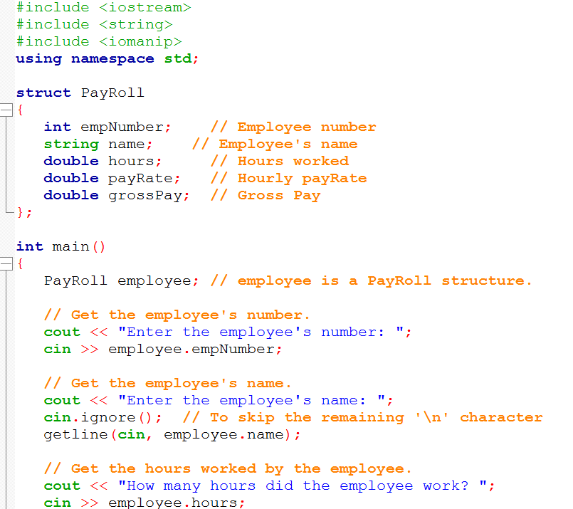

Slide 11
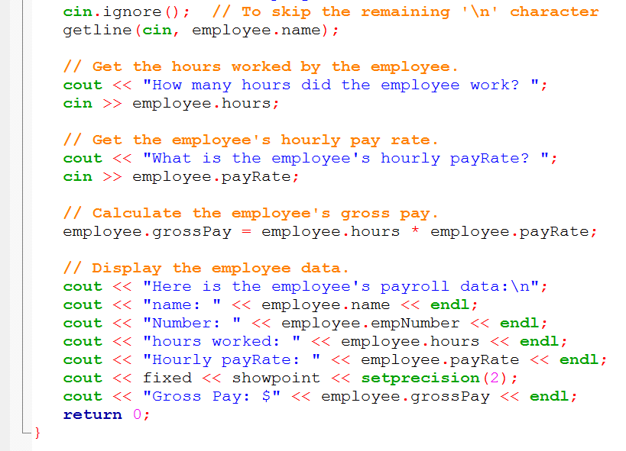

Slide 12
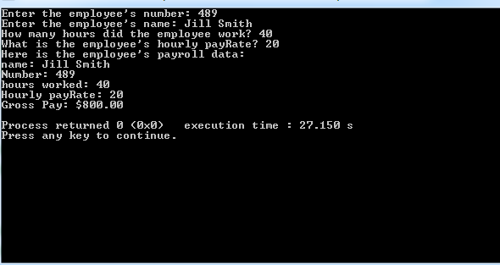

Slide 13
Displaying a struct Variable
To display the contents of a struct variable, must display each field separately, using the dot operator:
cout << bill; // won’t work
cout << bill.studentID << endl;
cout << bill.name << endl;
cout << bill.yearInSchool;
cout << " " << bill.gpa;

Slide 14
Comparing struct Variables
Cannot compare struct variables directly:
if (bill == william) // won’t work
Instead, must compare on a field basis:
if (bill.studentID ==
william.studentID) ...

Slide 15
Initializing a Structure
struct variable can be initialized when defined:
Student studentOne = {11465, "Joan", 2, 3.75};
Can also be initialized member-by-member after definition:
studentOne.name = "Joan";
studentOne.gpa = 3.75;

Slide 16
More on Initializing a Structure
May initialize only some members:
Student bill = {14579};
Cannot skip over members:
Student studentOne
= {1234, "John", , 2.83}; // illegal
Cannot initialize in the structure declaration, since this does not allocate memory

Slide 17
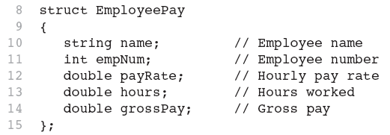
Excerpts From a Program

Slide 18
Duplicate Names
Member variable names duplicated between structure types are not a problem. super_grow.quantity and apples.quantity are different variables stored in different locations
struct FertilizerStock { double quantity; double nitrogen_content; }; FertilizerStock super_grow;
struct CropYield { int quantity; double size; }; CropYield apples;

Slide 19
One more thing…
struct product
{
int weight;
double price;
} object-names bolt, screw, washer;
IS THE SAME AS …
struct product
{
int weight;
double price;
} ;
product bolt;
product screw, washer;

Slide 20
Arrays of Structures
Structures can be defined in arrays
Can be used in place of parallel arrays const int NUM_STUDENTS = 20; Student stuList[NUM_STUDENTS];
Individual structures accessible using subscript notation
Fields within structures accessible using dot notation:
cout << stuList[5].studentID;

Slide 21
Arrays of Structures
And , of course, arrays can be defined in Structures
Can also another structure inside (must be declared too
struct Student
{
char firstName[15];
char lastName[15];
struct Address homeAddress;
};

Slide 22
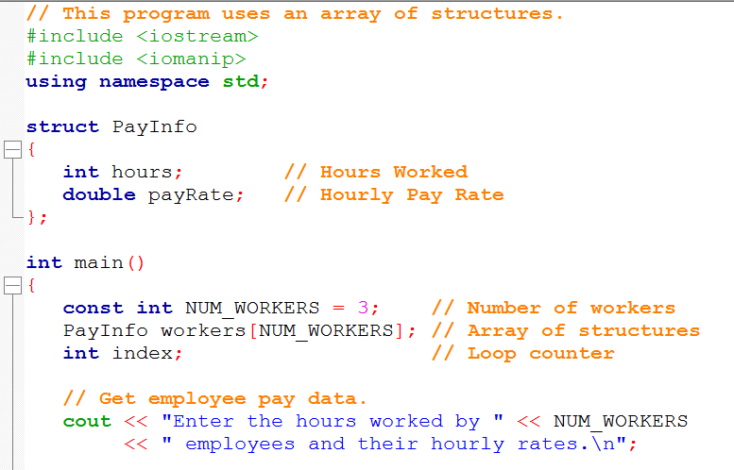

Slide 23
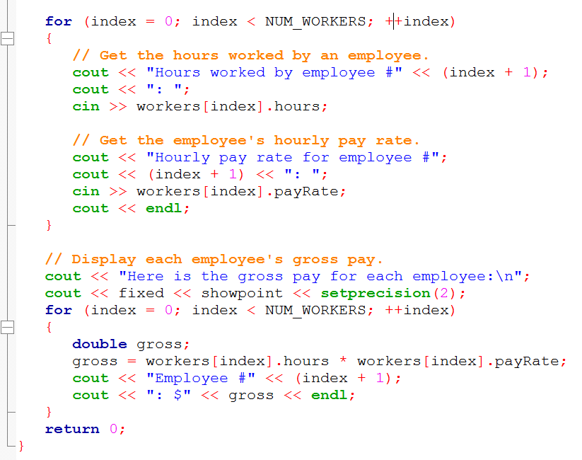

Slide 24
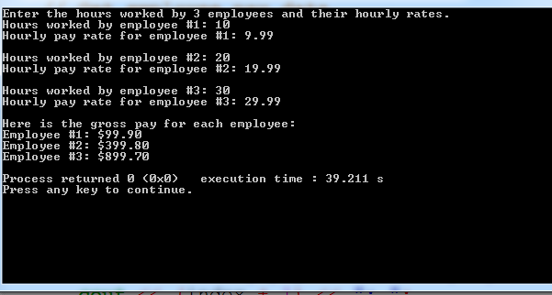

Slide 25
Inventory example
struct inventory
{
int part_no;
float cost;
float price;
};
struct inventory table[4];

Slide 26
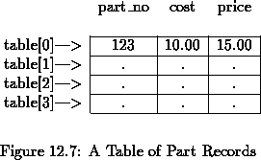
Inventory example
struct inventory
{
int part_no;
float cost;
float price;
};
struct inventory table[4];

Slide 27
Arrays of Structs
struct Data
{
double time[10];
int distance;
};
Data myBest;
myBest.distance = 20;
//You can set the ten array elements with //values from the keyboard as follows:
cout << "Enter ten times (in seconds):\n";
for (int i = 0; i < 10; i++)
cin >> myBest.time[i];

Slide 28
Vector of structs
#include <iostream>
#include <vector>
struct date
{
int month;
int day;
int year;
// Default constructor:
date()
{
month = 0;
day = 0;
year = 0;
}
// Constructor:
date( int month_, int day_, int year_ )
{
month = month_;
day = day_;
year = year_;
}
};//struct date
int main(int argc, char* argv[])
{
std::vector< date > week( 7 );
week[ 0 ] = date( 4, 8, 2007 );
week[ 1 ] = date( 4, 9, 2007 );
week[ 2 ] = date( 4, 10, 2007 );
week[ 3 ] = date( 4, 11, 2007 );
week[ 4 ] = date( 4, 12, 2007 );
week[ 5 ] = date( 4, 13, 2007 );
week[ 6 ] = date( 4, 14, 2007 );
return 0;
}

Slide 29
Initializing
A structure can be initialized when declared
Example: struct date { int month; int day; int year; };
Can be initialized in this way date due_date = {12, 31, 2004};

Slide 30
Nested Structures
A structure can contain another structure as a member:
struct PersonInfo
{ string name,
address,
city;
};
struct Student
{
int studentID;
PersonInfo pData;
short yearInSchool;
double gpa;
};

Slide 31
Members of Nested Structures
Use the dot operator multiple times to refer to fields of nested structures:
Student s;
s.pData.name = "Joanne";
s.pData.city = "Tulsa";

Slide 32
Nested Structures…continued
struct movies_t
{
string title;
int year;
};
struct friends_t {
string name;
string email;
movies_t favorite_movie;
} charlie, maria;
friends_t *pfriends = &charlie;
charlie.name
maria.favorite_movie.title
charlie.favorite_movie.year
pfriends->favorite_movie.year

Slide 33
Structures as Function Arguments
May pass members of struct variables to functions:
computeGPA(&stu.gpa);
May pass entire struct variables to functions:
showData(&stu);
… { stu XYZ;
XYZ.member1 = 234;
XYZ.member2 = 34.09;
return XYZ; }
Can use reference parameter if function needs to modify contents of structure variable

Slide 34
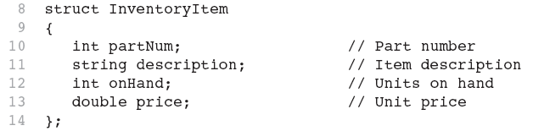
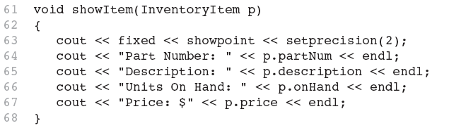
Excerpts from a Program

Slide 35
Structures as Arguments
Structures can be arguments in function calls
The formal parameter can be call-by-value
The formal parameter can be call-by-reference
Example: void get_data(CDAccount &the_account);
Uses the structure type CDAccount we saw earlier as the type for a call-by-reference parameter

Slide 36
Structures as Function Arguments - Notes
Using value parameter for structure can slow down a program, waste space
Using a reference parameter will speed up program, but function may change data in structure
Using a const reference parameter allows read-only access to reference parameter, does not waste space, speed

Slide 37
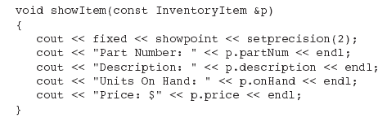
Revised showItem Function

Slide 38
Returning a Structure from a Function
Function can return a struct:
Student getStudentData(); // prototype
stu1 = getStudentData(); // call
Function must define a local structure
for internal use
for use with return statement

Slide 39
Returning a Structure from a Function - Example
Student getStudentData()
{
Student tempStu;
cin >> tempStu.studentID;
getline(cin, tempStu.pData.name);
getline(cin, tempStu.pData.address);
getline(cin, tempStu.pData.city);
cin >> tempStu.yearInSchool;
cin >> tempStu.gpa;
return tempStu;
}

Slide 40
Structures as Return Types
Structures can be the type of a value returned by a function
Example: CDAccount shrink_wrap(double the_balance, double the_rate, int the_term) { CDAccount temp; temp.balance = the_balance; temp.interest_rate = the_rate; temp.term = the_term; return temp; }

Slide 41
Using Function shrink_wrap
shrink_wrap builds a complete structure value in temp, which is returned by the function
We can use shrink_wrap to give a variable of type CDAccount a value in this way: CDAccount new_account; new_account = shrink_wrap(1000.00, 5.1, 11);

Slide 42
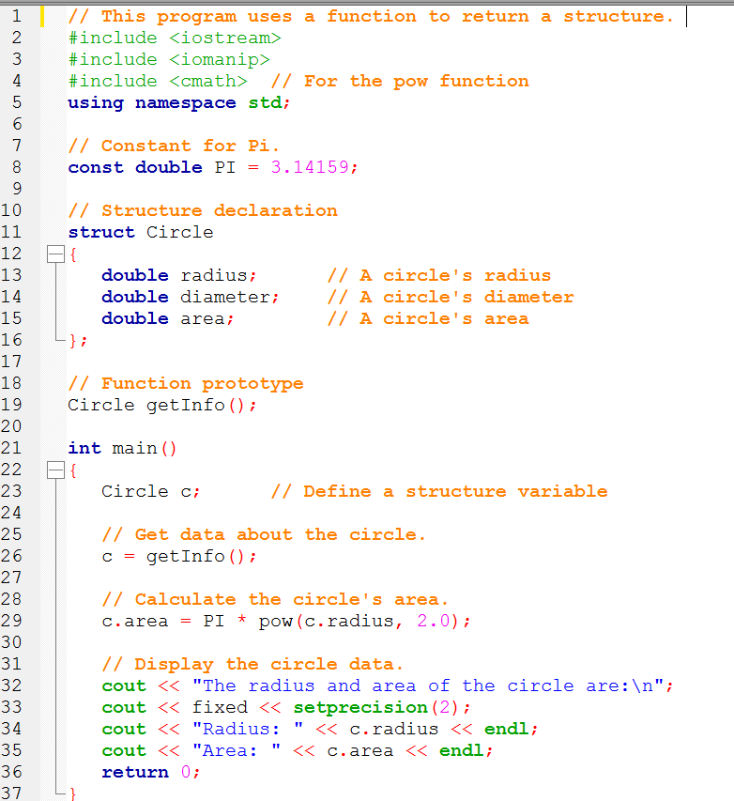

Slide 43
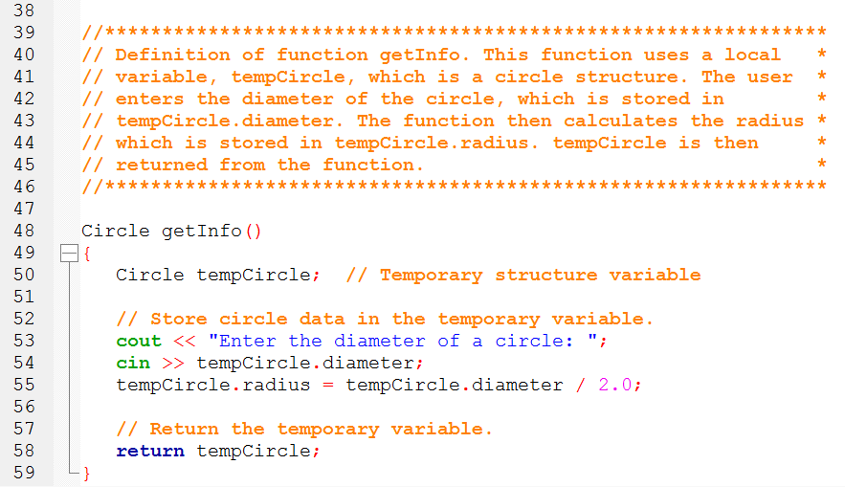
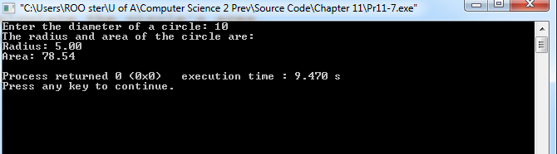

Slide 44
Pointers to Structures
A structure variable has an address
Pointers to structures are variables that can hold the address of a structure:
Student *stuPtr;
Can use & operator to assign address:
stuPtr = & stu1;
Structure pointer can be a function parameter

Slide 45
Accessing Structure Members via Pointer Variables
Must use () to dereference pointer variable, not field within structure:
cout << *stuPtr.studentID;
cout << (*stuPtr).studentID;
Can use structure pointer operator to eliminate () and use clearer notation:
cout << stuPtr->studentID;
stuPtr->studentID is the same as (*stuPtr).studentID

Slide 46
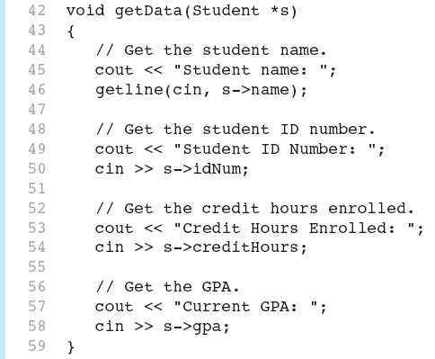
From A Program

Slide 47
Information hiding and structs
Rule: Make data members private, except in behaviorless aggregates (C-style structs).
Summary
They're none of your caller's business: Keep data members private. However, and only in the case of simple C-style struct types that aggregate a bunch of values but don't pretend to encapsulate or provide behavior, you will make all data members public

Slide 48
Efficiency notes regarding Structs
Class data members (properties)
The data members of a class or structure are stored consecutively in the order in which they are declared whenever an instance of the class or structure is created. There is no performance penalty for organizing data into classes or structures. Accessing a data member of a class or structure object takes no more time than accessing a simple variable.

Slide 49
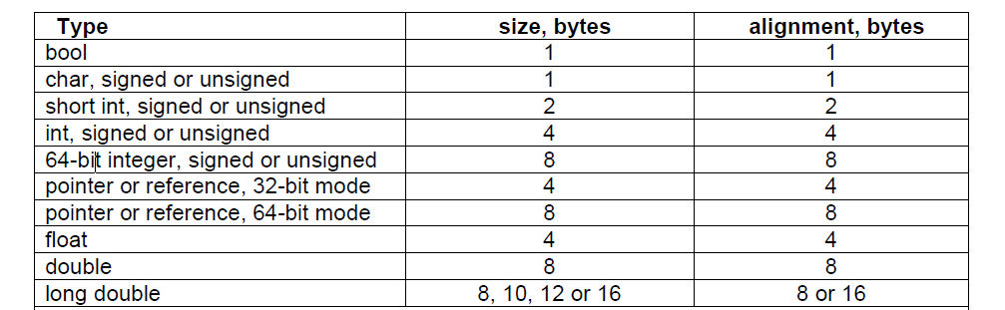
Efficiency notes regarding Structs

Slide 50
Efficiency notes regarding Structs
struct S1
{
short int a; // 2 bytes. first byte at 0, last byte at 1
// 6 unused bytes
double b; // 8 bytes. first byte at 8, last byte at 15
int d; // 4 bytes. first byte at 16, last byte at 19
// 4 unused bytes
};
S1 ArrayOfStructures[100];
This alignment can cause holes of unused bytes in a structure or class with members of mixed sizes

Slide 51
Efficiency notes regarding Structs
struct S1
{
double b; // 8 bytes. 1st byte at 8, last byte at 7
int d; // 4 bytes. 1st byte at 16, last byte at 11
short int a; // 2 bytes. 1st byte at 0, last byte at 13
// 2 unused bytes
};
S1 ArrayOfStructures[100];
The number of unused bytes can be reduced to 2 by putting the smallest members last

Slide 52
Efficiency notes regarding Structs
Rule: Reorder data members for structures or class objects to make them smaller.
Structure and class objects can often be made smaller by reordering the data members. If the class has at least one virtual member functions then there is a pointer to a virtual table before the first data member or after the last member. This pointer is 4 bytes in 32-bit systems and 8 bytes in 64-bit systems. If you are in doubt how big a structure or each of its members are then you may make some tests with the sizeof operator..

Slide 53
Q & A
What is a c++ struct? Is it a class?
How do you refer to items in the struct?
Can we compare structs?
How do you code to reference fields in nested structures?
Create a pointer named ptr and set it to the struct called bigStruct.
Access the item stuff in bigStruct using the pointer ptr.

Slide 54

structs are functionally the same as classes, except for default member/inheritance access
Some think we should use a struct for types that contain mostly data, and a class for applications that benefit from more procedural encapsulation.

Slide 55
References
Slide contributions include:
Walter Savitch, Problem solving with C++ (9th Edition). Addison-Wesley Longman Publishing Co., Inc. Boston, MA, USA ©2015
Gaddis, Starting Out with C++: From Control Structures through Objects, (8th Ed.) , Addison-Wesley Longman Publishing Co., Inc. Boston, MA, USA ©2015
Bjarne Stroustrup, The C++ Programming Language, 3rd Edition, Addison-Wesley Longman Publishing Co., Inc. Boston, MA, USA ©2007
Herb Sutter, Andrei Alexandrescu, C++ coding standards : 101 rules, guidelines, and best practices, Copyright © 2005 Pearson Education, Inc.
Paul Deitel & Harvey Deitel, C++ How to Program, (7th Ed.) © 2010 by Pearson Education, Inc.
Upper Saddle River, New Jersey 07458
Scott Meyers, Effective Modern C++. Copyright © 2015 (O’Reilly) , 978-1-491-90399-5.
Andrew Koenig and Barbara E. Moo, Accelerated C++ Practical Programming by Example,
Addison-Wesley, 2000 ISBN 0-201-70353-X

